Slide 1
DICTIONARY

Slide 2
What is a Dictionary
A Dictionary class is a data structure that represents a collection of keys and values pair of data.
The Dictionary in C# is a Generic Collection that stores the element in the form of Key-Value Pairs. The working of the Generic Dictionary is very much similar to the working of the Non-Generic Hashtable collection. The difference is while creating the generic dictionary object we need to specify the type for both the keys as well as the type for values. As Dictionary<TKey, TValue> is a generic collection class, so it belongs to System.Collection.Generic namespace. The generic Dictionary<TKey, TValue> collection is dynamic in nature means the size of the dictionary is automatically increase as we added items to the collection
Few Key Pointers
In Generic Dictionary<TKey, TValue> Collection, the key cannot be null, but the value can be null if its type TValue is a reference type.
Every key in Generic Dictionary<TKey, TValue> Collection must be unique. Duplicate keys are not allowed. If you try to add a duplicate key then the compiler will throw an exception.
In Generic Dictionary<TKey, TValue> Collection, you can only store the same types of elements.
The capacity of a Dictionary collection is the number of elements that the Dictionary can hold..

Slide 3
How to create a Generic Dictionary Collection
The Generic Dictionary Collection class in C# provided the following constructors that we can use to create an instance of the Dictionary collection class.
Dictionary(): It initializes a new instance of the Generic Dictionary class that is empty, has the default initial capacity and uses the default equality comparer for the key type.
Dictionary(IDictionary<TKey, TValue> dictionary): It initializes a new instance of the Generic Dictionary class that contains elements copied from the specified System.Collections.Generic.IDictionary and uses the default equality comparer for the key type.
Dictionary(IEnumerable<KeyValuePair<TKey, TValue>> collection): It initializes a new instance of the Generic Dictionary class that contains elements copied from the specified System.Collections.Generic.IDictionary and uses the default equality comparer for the key type.
Dictionary(IEqualityComparer<TKey>? comparer): It initializes a new instance of the Generic Dictionary class that is empty, has the default initial capacity, and uses the specified System.Collections.Generic.IEqualityComparer.
Dictionary(int capacity): It initializes a new instance of the Generic Dictionary class that is empty, has the specified initial capacity and uses the default equality comparer for the key type.
Dictionary(IDictionary<TKey, TValue> dictionary, IEqualityComparer<TKey>? comparer): It initializes a new instance of the Generic Dictionary class that contains elements copied from the specified System.Collections.Generic.IDictionary and uses the specified System.Collections.Generic.IEqualityCompare.
Dictionary(int capacity, IEqualityComparer<TKey>? comparer): It initializes a new instance of the Generic Dictionary class that is empty, has the specified initial capacity, and uses the specified System.Collections.Generic.IEqualityComparer.
Dictionary(SerializationInfo info, StreamingContext context): It initializes a new instance of the Generic Dictionary class with serialized data.

Slide 4
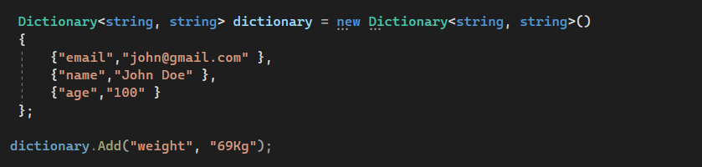
How to Add Elements into a Generic Dictionary<TKey, TValue> Collection
Now, if you want to add elements i.e. a key/value pair into the Dictionary, then you need to use the following Add() method of the Generic Dictionary Collection Class in C#.
Add(TKey key, TValue value): The Add(TKey key, TValue value) method is used to add an element with the specified key and value into the Dictionary. Here, the parameter key specifies the key of the element to add and the parameter value specifies the value of the element to add. The value can be null for a reference type but the Key cannot be null.

Slide 5
How to access a Generic Dictionary<TKey, TValue> Collection
Using Key to access Dictionary<TKey, TValue> Collection
You can access the individual value of the Dictionary collection in C# by using the keys. In this case, we just need to specify the key to get the value from the given dictionary, no need to specify the index position. If the specified key is not present, then the compiler will throw an exception.
Using for-each loop to Access Dictionary<TKey,TValue> Collection
We can also use a for-each loop to access the key/value pairs of a Dictionary<TKey, TValue>
Using for loop to Access Dictionary<TKey, TValue> Collection
We can also access the Dictionary<TKey, TValue> collection in C# using a for loop as follows. The ElementAt method belongs to the static Enumerable class which is defined in System.Linq namespace.

Slide 6
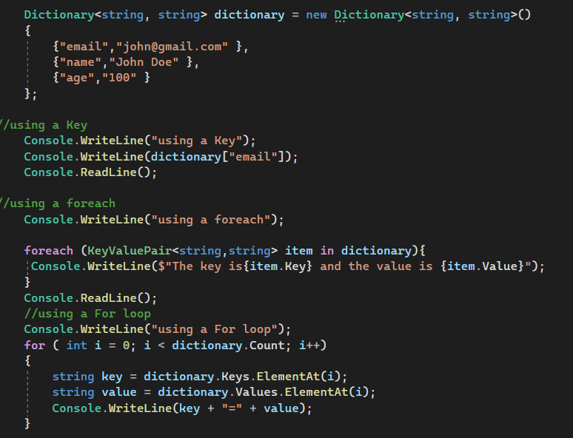
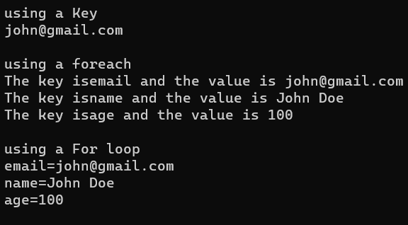

Slide 7
How to Check the Availability of a key/value Pair in a Dictionary
If you want to check whether the key/value pair exists or not in the Dictionary collection, then you can use the following methods of the Generic Dictionary Collection Class in C#.
ContainsKey(TKey key): The ContainsKey(TKey key) method of the Dictionary is used to check if the given key is present in the Dictionary or not. The parameter key to locating in the Dictionary object. If the given key is present in the collection, then it will return true else it will return false. If the key is null, then it will throw System.ArgumentNullException.
ContainsValue(TValue value): The ContainsValue(TValue value) Method of the Dictionary class is used to check if the given value is present in the Dictionary or not. The parameter value to locate in the Dictionary object. If the given value is present in the collection, then it will return true else it will return false.

Slide 8
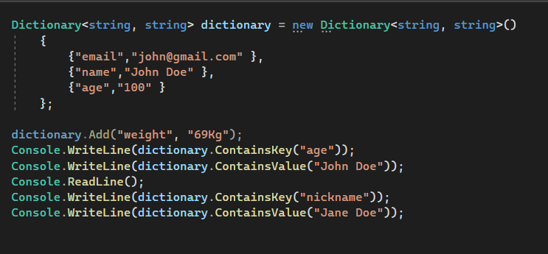
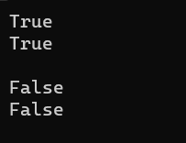

Slide 9
How to Remove Elements from a Generic Dictionary Collection
If you want to remove an element from the Dictionary, then you can use the following Remove method of the Dictionary collection class.
Remove(TKey key): This method is used to remove the element with the specified key from the Dictionary collection. Here, the parameter key specifies the element to remove. It throws KeyNotfoundException if the specified key is not found in the Dictionary, so check for an existing key using the ContainsKey() method before removing it.
If you want to remove all the elements from the Dictionary collection, then you need to use the following Clear method of the Dictionary class in C#.
Clear(): This method is used to remove all elements i.e. all the keys and values from the Dictionary object.

Slide 10
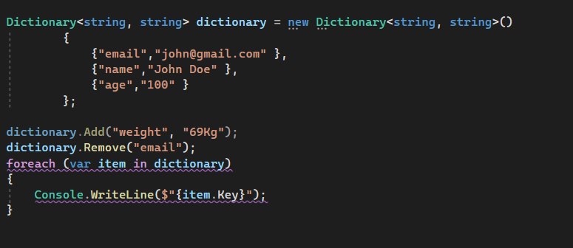
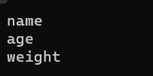

Slide 11
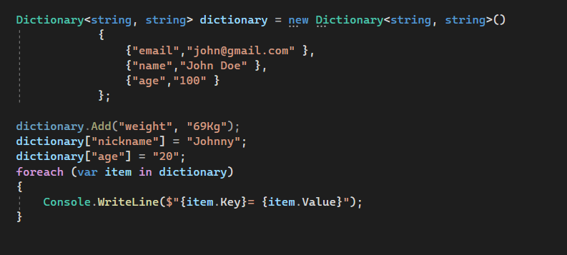
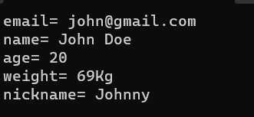
How to Assign/Update Values to a Dictionary with Indexer
In order to add value to a Dictionary with an indexer, we need to use square brackets after the Dictionary name. This is because a Dictionary works with key/value pairs, and we have to specify both key and value while adding the elements. The key is specified between square brackets. The syntax is given below.
dictionary[key] = value;

Slide 12
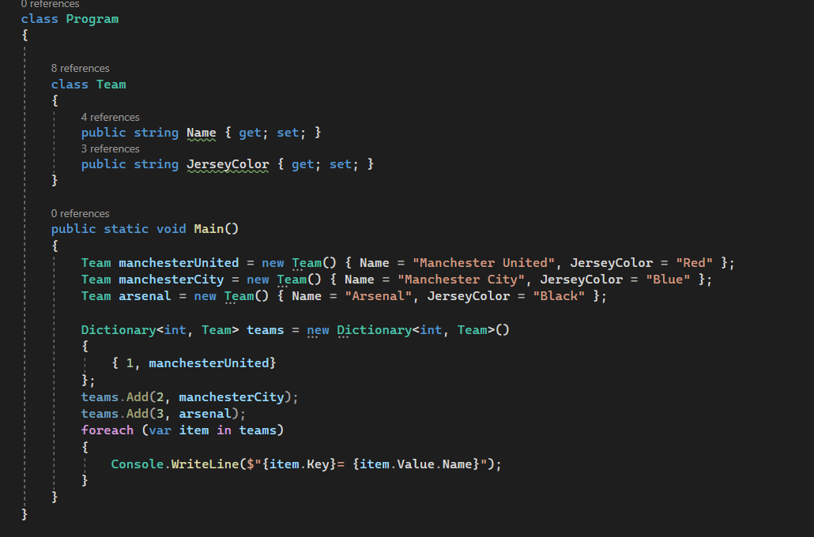
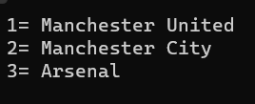
Complex Dictionary

Slide 13
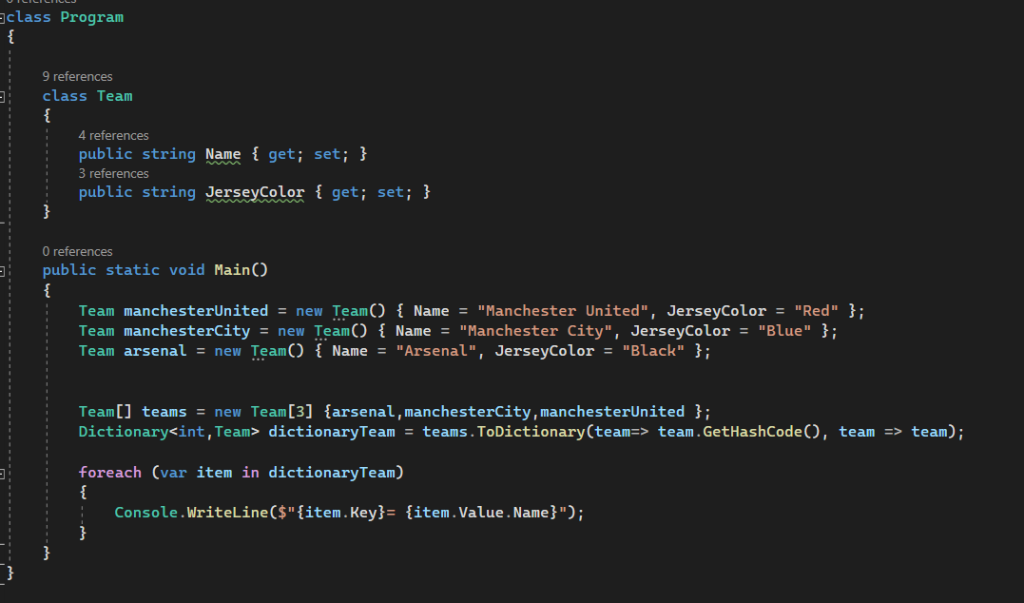
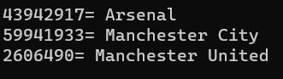
How to Convert an Array to a Dictionary
To convert an array to a dictionary we need to use the ToDictionary() method. For a better understanding please have a look at the below example. In the below example, we are converting the Student array to a dictionary using the ToDictionary() method.

Slide 14
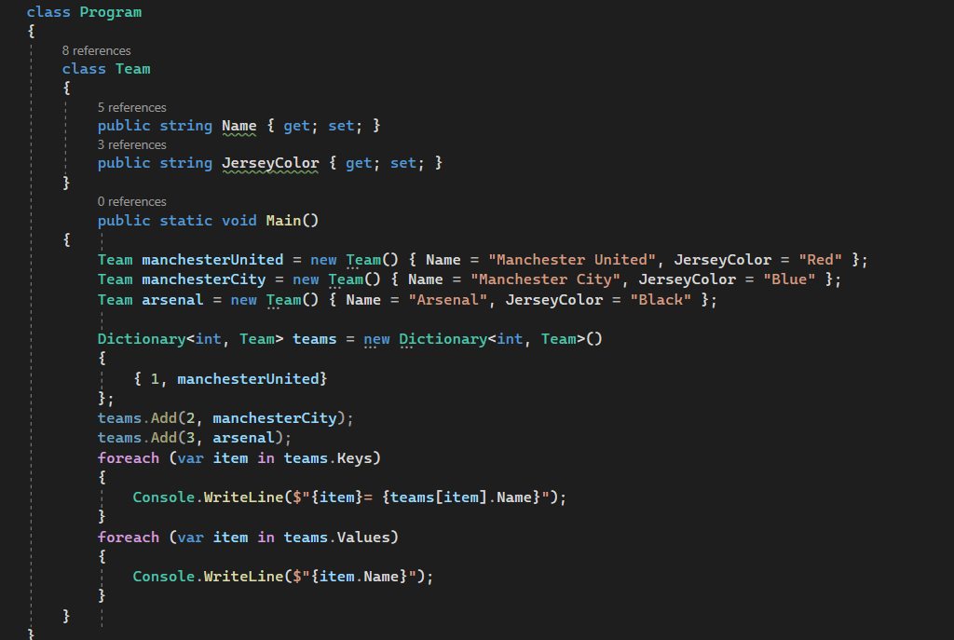
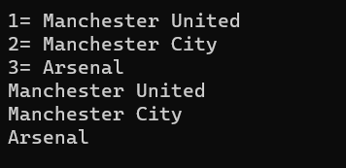
How to get all the keys and Values of a Dictionary
To get all the keys in the dictionary we have to use the Keys properties of the dictionary object. To get all the values of a dictionary, first, we need to get the keys, then we need to get the values using the keys

Slide 15
Generic Dictionary Collection Class Summary
A dictionary is a collection of key-value pairs.
The Dictionary Generic Collection class is present in System.Collections.Generic namespace.
When creating a dictionary, we need to specify the type for the key as well as the type for the value.
The fastest way to find a value in a dictionary is by using the keys.
Keys in a dictionary must be unique keys

Slide 16
Conversion to and From Dictionary
Convert an array to a List – Use ToList() method
Convert a list to an array – Use ToArray() method
Convert a List to a Dictionary – Use ToDictionary() method
Convert an array to a Dictionary – Use ToDictionary() method
Convert a Dictionary to an array – Use ToArray() method on the Values Property of the dictionary object
Convert a Dictionary to a List – Use the ToList() method on the Values Property of the dictionary object

